Slide 1
Apache Kafka
Presented By:
Amirreza Bary Haghighi
Student Number:
9661251

Slide 2
Introduction
Apache Kafka was originated at LinkedIn and later became an open sourced Apache project in 2011, then First-class Apache project in 2012. Kafka is written in Scala and Java. Apache Kafka is publish-subscribe based fault tolerant messaging system. It is fast, scalable and distributed by design.

Slide 3
challenges
In Big Data, an enormous volume of data is used. Regarding data, we have two main challenges. The first challenge is how to collect large volume of data and the second challenge is to analyze the collected data. To overcome those challenges, you must need a messaging system.

Slide 4
What is a Messaging System?
A Messaging System is responsible for transferring data from one application to another, so the applications can focus on data, but not worry about how to share it.
Two types of messaging patterns are available − one is point to point and the other is publish-subscribe (pub-sub) messaging system.

Slide 5
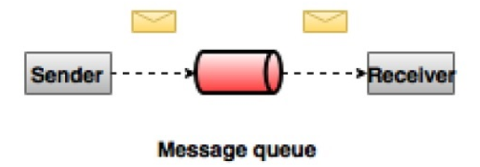
Point to Point Messaging System
In a point-to-point system, messages are persisted in a queue. One or more consumers can consume the messages in the queue, but a particular message can be consumed by a maximum of one consumer only. Once a consumer reads a message in the queue, it disappears from that queue. The typical example of this system is an Order Processing System.

Slide 6
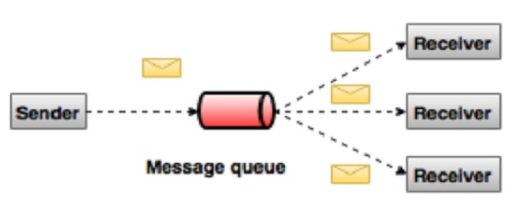
Publish-Subscribe Messaging System
In the publish-subscribe system, messages are persisted in a topic. Unlike point-to-point system, consumers can subscribe to one or more topic and consume all the messages in that topic. In the Publish-Subscribe system, message producers are called publishers and message consumers are called subscribers. A real-life example is Dish TV.

Slide 7
What is Kafka?
Apache Kafka is a distributed publish-subscribe messaging system and a robust queue that can handle a high volume of data and enables you to pass messages from one end-point to another. Kafka is suitable for both offline and online message consumption. Kafka messages are persisted on the disk and replicated within the cluster to prevent data loss.

Slide 8
Familiar with some terminologies
Topics:
A stream of messages belonging to a particular category is called a topic. Data is stored in topics.
Partition:
Topics may have many partitions, so it can handle an arbitrary amount of data.
Brokers:
Brokers are simple system responsible for maintaining the published data. Each broker may have zero or more partitions per topic. Assume, if there are N partitions in a topic and N number of brokers, each broker will have one partition.

Slide 9
Familiar with some terminologies
Kafka Cluster:
Kafka’s having more than one broker are called as Kafka cluster. A Kafka cluster can be expanded without downtime. These clusters are used to manage the persistence and replication of message data.
Producers
Producers are the publisher of messages to one or more Kafka topics. Producers send data to Kafka brokers. Every time a producer publishes a message to a broker, the broker simply appends the message to the last segment file. Actually, the message will be appended to a partition. Producer can also send messages to a partition of their choice.

Slide 10
Familiar with some terminologies
Consumers
Consumers read data from brokers. Consumers subscribes to one or more topics and consume published messages by pulling data from the brokers.
Leader
is the node responsible for all reads and writes for the given partition. Every partition has one server acting as a leader.
Follower:
Node which follows leader instructions are called as follower. If the leader fails, one of the follower will automatically become the new leader. A follower acts as normal consumer, pulls messages and up-dates its own data store

Slide 11
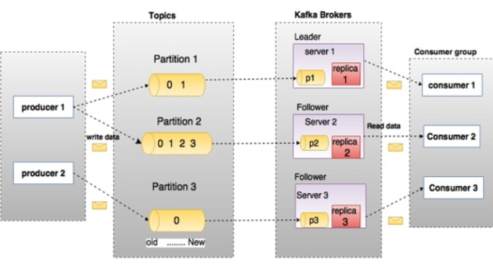

Slide 12
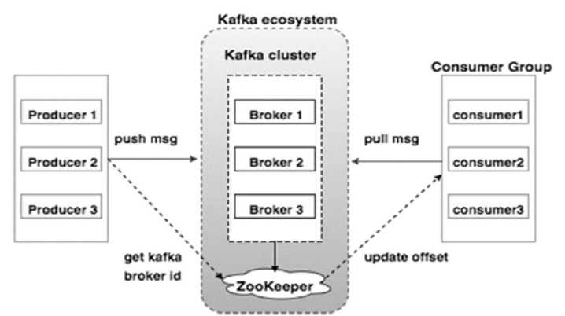
Cluster Architecture

Slide 13
Broker:
Kafka cluster typically consists of multiple brokers to maintain load balance. Kafka brokers are stateless, so they use Zookeeper for maintaining their cluster state. One Kafka broker instance can handle hundreds of thousands of reads and writes per second and each broker can handle TB of messages without performance impact. Kafka broker leader election can be done by Zookeeper.
Zookeeper:
Zookeeper is used for managing and coordinating Kafka broker. Zookeeper service is mainly used to notify producer and consumer about the presence of any new broker in the Kafka system or failure of the broker in the Kafka system. As per the notification received by the Zookeeper regarding presence or failure of the broker then producer and consumer takes decision and starts coordinating their task with some other broker.

Slide 14
Producers:
Producers push data to brokers. When the new broker is started, all the producers search it and automatically sends a message to that new broker. Kafka producer doesn’t wait for acknowledgements from the broker and sends messages as fast as the broker can handle.
Consumers
Since Kafka brokers are stateless, which means that the consumer has to maintain how many messages have been consumed by using partition offset. If the consumer acknowledges a particular message offset, it implies that the consumer has consumed all prior messages.

Slide 15
Benefits
Reliability : Kafka is distributed, partitioned, replicated and fault tolerance.
Scalability:Kafka messaging system scales easily without down time
Durability: Kafka uses Distributed commit log which means messages persists on disk as fast as possible, hence it is durable.
Performance:Kafka has high throughput for both publishing and subscribing messages. It maintains stable performance even many TB of messages are stored.

Slide 16
Integration with Apache Storm
Introduction:
Apache Storm became a standard for distributed real-time processing system that allows you to process a huge volume of data. Storm is very fast and a benchmark clocked it at over a million tuples processed per second per node.
Integration Kafka with Storm:
Kafka and Storm naturally complement each other, and their powerful cooperation enables real-time streaming analytics for fast-moving big data. Kafka and Storm integration is to make easier for developers to ingest and publish data streams from Storm topologies.

Slide 17
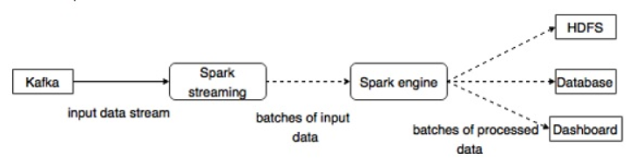
Integration with Apache Spark
Kafka is a potential messaging and integration platform for Spark streaming. Kafka act as the central hub for real-time streams of data and are processed using complex algorithms in Spark Streaming. Once the data is processed, Spark Streaming could be publishing results into yet another Kafka topic or store in HDFS, databases or dashboards. The following diagram depicts the conceptual flow.

Slide 18
Applications
Twitter
Twitter is an online social networking service that provides a platform to send and receive user tweets. Registered users can read and post tweets, but unregistered users can only read tweets. Twitter uses Storm-Kafka as a part of their stream processing infrastructure.
LinkedIn
Apache Kafka is used at LinkedIn for activity stream data and operational metrics.

Slide 19
Applications
Netflix
Netflix is an American multinational provider of on-demand Internet streaming media. Netflix uses Kafka for real-time monitoring and event processing.
Mozilla
Mozilla is a free-software community, created in 1998 by members of Netscape. Kafka will soon be replacing a part of Mozilla current production system to collect performance and usage data from the end-user’s browser for projects like Telemetry, Test Pilot, etc.

Slide 20
Apache Kafka - Tools
System Tools
System tools can be run from the command line using the run class script.
Some of the system tools:
Kafka Migration Tool
Mirror Maker
Consumer Offset Checker
….

Slide 21
Apache Kafka - Tools
Replication Tool
Kafka replication is a high level design tool. The purpose of adding replication tool is for stronger durability and higher availability.
Some of the system tools:
Create Topic Tool
List Topic Tool
Add Partition Tool
…..

Slide 22


